Slide 1
Software Engineering
Lesson 1 – Agile Development
LO1 : Plan and tackle a small software design project as part of a team using an Agile approach.

Slide 2
Lesson Objectives
Understanding Agile Development and the philosophy behind Agile Methodology.
Familiarizing with the contents of the Agile Manifesto which include
Values of Agile Methodologies
Principles of Agile Development
Familiarizing with important traits of Agile Development which include
Code Refactoring
Customer Involvement and CRACK Representatives
Recognizing the Applicability of Agile Development
Recognizing weak points in Agile Development

Slide 3

Brain Storimg Session
Write down the first thing that comes to mind when you hear the word
Agile
Notes:
Instructions for Brain Storming:
If possible seat students in a semi - circle so that everyone including yourself is facing each other and the board
Hand out a piece of paper to the students (or ask them to use one of their own)
Ask them to write down the first thing that comes to mind when they hear the word Agile (one word is enough)
Students have 30seconds to think and they should keep what they have written to themselves initially
Once the 30seconds elapse, ask students to flip their papers so that everyone can see what is written
By using the students’ own impressions of the meaning of Agile construct a definition for Agile Development

Slide 4
What is Agile Development?
Definition :
“Agile development is a phrase used in software development to describe methodologies for incremental software development.”
“Agile development is an alternative to traditional project management where emphasis is placed on empowering people to collaborate and make team decisions in addition to continuous planning, continuous testing and continuous integration”
Source : http://www.webopedia.com/TERM/A/agile_software_development.html

Slide 5
What is Agile Development?
In simpler terms:
Agile software development focuses on keeping code simple, testing often, and delivering functional bits of the application as soon as they're ready; therefore giving the client part of a finished product more quickly.
It acknowledges that not everything can be catered for in advance and that changes to the code will be necessary as the project progresses – therefore it acknowledges the need for flexibility
The goal is to build upon small client-approved parts as the project progresses, making changes as necessary, instead of delivering one large application at the end.
Notes:
Adapted from : http://searchsoftwarequality.techtarget.com/definition/agile-software-development

Slide 6
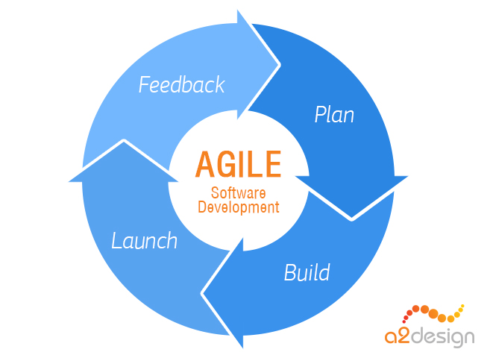
What is Agile Development?
In fact all Agile Methodologies are :
Low Ceremony
Small Size
Emphasize User Participation
Work using Small, Co-located teams.
Embrace change both in requirements and the development process itself through the use of discussion and feedback.

Slide 7
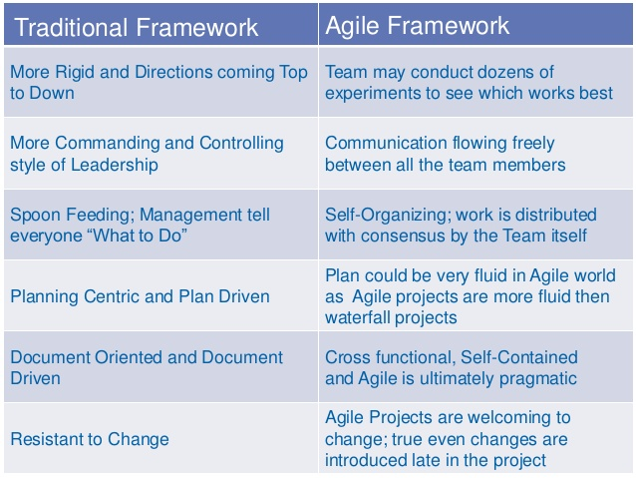
Agile vs Traditional Development

Slide 8
Making Sense of it…..
Now that you have a better idea of what Agile Development is, write down your own definition of
Agile Development
Go for something that is short, clear and easy for you to remember!
Notes:
Instructions
Allow students 2 – 3 minutes to digest what has been said and to come up with their own definition of Agile Development
Encourage short definitions (max 2 sentences) which are easy for them to remember
Avoid the use of jargon and complicated terms – this will not help in remembering what Agile Development is all about
At the end of the 2 -3 minutes ask some students to share their definition of Agile Development

Slide 9
The Agile Philosophy
The Agile Development Philosophy is all about :
“The right people, with the right skills and the right ideas lead to the Right Software!”
These beliefs are at the core values and principles of Agile Development and are documented in the Agile Manifesto
Link to Agile Manifesto : http://agilemanifesto.org/

Slide 10

What is the Agile Manifesto ?
Source : https://www.youtube.com/watch?v=rf8Gi2RLKWQ

Slide 11
The Agile Manifesto - Values
The Four Key Values of Agile Development :
“We are uncovering better ways of developing software by doing it and helping others do it. Through this work we have come to value:
Individuals and Interactions over processes and tools
Working Software over comprehensive documentation.
Customer Collaboration over contract negotiation.
Responding to Change over following a plan.
That is, while there is value in the items on the right, we value items on the left more.”
Notes:
This is possibly the most famous quote from the Agile Manifesto Itself.

Slide 12
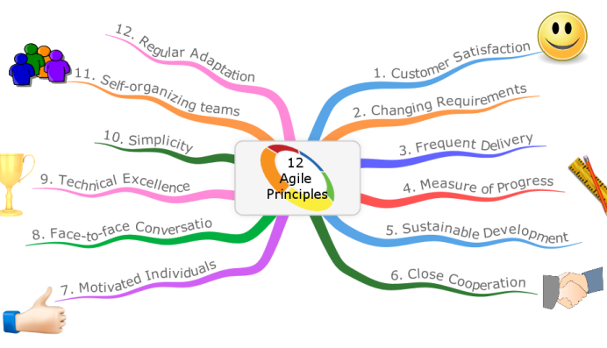
The Agile Manifesto - Principles

Slide 13
The Agile Manifesto - Principles
The Twelve Principles of Agile Development :
Satisfying 'customers' through early and continuous delivery of valuable work.
Breaking big work down into smaller components that can be completed quickly.
Recognizing that the best work emerges from self-organizing teams.
Providing motivated individuals with the environment and support they need and trust them to get the job done.

Slide 14
The Agile Manifesto - Principles
The Twelve Principles of Agile Development :
Creating processes that promote sustainable efforts.
Maintaining a constant pace for completed work.
Welcoming changing requirements, even late in a project.
Assembling the project team and business owners on a daily basis throughout the project.

Slide 15
The Agile Manifesto - Principles
The Twelve Principles of Agile Development :
At regular intervals, having the team reflect upon how to become more effective, then tuning and adjusting behavior accordingly.
Measuring progress by the amount of completed work.
Continually seeking excellence.
Harnessing change for competitive advantage.

Slide 16
Traits of Agile Methodologies
An iterative and incremental (evolutionary) approach to software development which can accommodate the changing needs of its stakeholders, even late in the development cycle.
Least Design Up Front; the initial planning cycle is formal but on-going planning is carried out “as needed” to cater for changes that will be required. A lot of planning and scheduling early on might be carried out for nothing!
Self-Organizing teams which work in a highly collaborative manner; with loosely defined and overlapping roles and responsibilities to encourage everyone to contribute at all stages of the life cycle.

Slide 17
Traits of Agile Methodologies
Less formalities and bureaucracy in processes, roles and communication - the idea is to have "just enough" ceremony to produces high quality software in a cost effective and timely manner.
Continuous customer feedback and involvement which requires complete collaboration from all stakeholders. Communication is constant yet informal.
Project deliverables which focus more on prototypes and frequent releases of the system rather than documents and plan-driven approach where the final product is only seen towards the end of the life cycle.

Slide 18
Traits of Agile Methodologies
All the above traits of Agile Methodologies can be said to focus on two main characteristics of Agile Development :
Code Refactoring
Customer Involvement

Slide 19
Importance of Code Refactoring
What is Code Refactoring?
The process of clarifying and simplifying the design of existing code, without changing its behavior.
Agile teams maintain and extend their code a lot from iteration to iteration. With each new iteration, new functions are added t the software, changes to existing features are made and unexpected client requests may also have to be catered for!
Without continuous refactoring, this is hard to do.

Slide 20
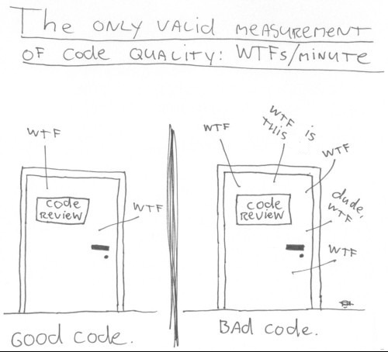
Importance of Code Refactoring
Why do we need Code Refactoring?

Slide 21
Importance of Code Refactoring
Why do we need Code Refactoring?
Unless we continuously try to improve and simplify our design to accommodate changes with every iteration, our code will ROT!
Code rot creates unhealthy dependencies between classes or packages, bad allocation of class responsibilities, way too many responsibilities per method or class, duplicate code, and many other varieties of confusion and clutter.
Why?

Slide 22
Importance of Code Refactoring
Why do we need Code Refactoring?
Just adding a new class or function to a piece of code without first making sure that the proper design exists to support this change is like adding wings to a car to make an aero plane!
It is just not built to fly!

Slide 23
Importance of Code Refactoring
Why do we need Code Refactoring?
We should alter the design to fit the necessary changes and not try to find a quick fix to include all the features in the next iteration.
This is because :
A quick fix is the road to a quick disaster.
BUT
Fixing inside fixes outside.
In an Agile context, this makes the difference between meeting or not meeting an iteration deadline.

Slide 24
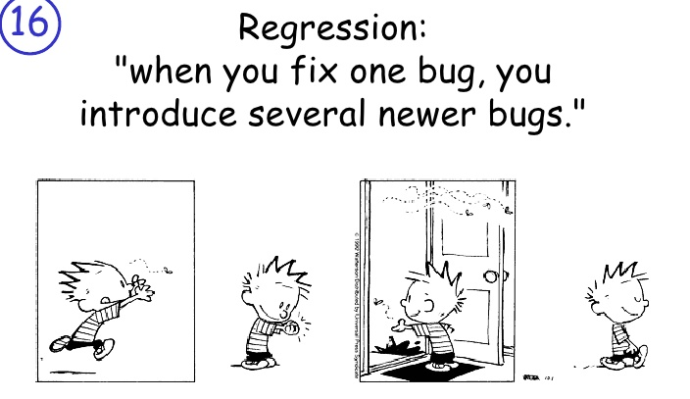
Importance of Code Refactoring
So Code Refactoring = Good Design = Quality Code, Right?
Not Exactly…..

Slide 25
Importance of Code Refactoring
Code Refactoring goes hand in hand with Unit Testing!
Without running tests after each little step in refactoring, there is the risk of introducing new bugs.
This is why we need Test-Driven Development (TDD) where unit testing is repeatedly done on source code and refactoring continuously carried out until each unit is functioning according to the desired specifications.

Slide 26
The CRACK Representatives
Agile Development is NOT for Everyone!
For Agile Development to work, you must have the right kind of people for the process i.e. you must have a small team of highly experienced and creative developers and the right sort of customers!
In order to be continuously involved in the process and able to provide the right sort of feedback to create the best system possible customers must be
CRACK Representatives!
Collaborative, Representative, Authorized, Committed and Knowledgeable

Slide 27
The CRACK Representatives
Collaborative
Customer Representatives must be willing to engage with their peers and with the development team to share ideas and discuss possible solutions
Representative
Customer Representatives must know what their company really needs! They must have a good idea of the product or system requirements and can represent their constituents accurately
Authorized
Customer Representatives must be able to take any decisions needed with regards to any proposed changes , otherwise this will only slow things down until formal approval is obtained from the people up top!

Slide 28
The CRACK Representatives
Committed
Customer Representatives must take their job seriously and make every effort to advance project success. The success of the new system must be something that they have truly at heart and which they believe will benefit their business.
Knowledgeable
Customer Representatives must be able to understand what the developers are telling them in the context of the business or market situation in order to be able to take the best decisions possible.

Slide 29
Brain Storimg Session
To be Agile ….
Or Not to be Agile…..
That is the Question!
Notes:
Instructions for Brain Storming:
Allow the students to work in groups of 2 or 3
Ask them to make two short lists :
Write down the situations when Agile Development is ideal to use
Write down the situations when Agile Development might not be the best option
Students have 3 – 5minutes to complete this exercise
Once the time has elapsed, ask each group to share their views

Slide 30
When to Use Agile Development?
Agile Methods have become popular for their ability to deliver high quality software in less time and with less costs than traditional software development methodologies.
“Agile isn’t a silver bullet”.
When implemented in the wrong manner Agile methods can decrease production, especially if the right organizational framework and people are not available!
Therefore it is important that make sure that Agile Development is truly the right methodology for your project
…How?

Slide 31
When to Use Agile Development?
Agile Methodologies are ideal to use when :
Requirements are subject to change
Small frequent iterations allow for changes to be effected whilst keeping costs low.
The team is small (max 10 members) and experienced
Discussions are not always viable with larger teams and the lack of documentation and clear role definition may not provide the necessary support to junior members.

Slide 32
When to Use Agile Development?
Agile Methodologies are ideal to use when :
The Return on Investment is highest priority
The software produced must increase the profits of the organization it is being developed and therefore requirements must be able to change quickly and at lowest cost in order to achieve the above.
The Organizational Culture must support communication to prevail
This requires little red-tape and excellent interpersonal skills from everyone involved so that ideas may flourish through discussion.

Slide 33
When to Use Agile Development?
Agile Methodologies are ideal to use when :
The Project is not of a Critical Nature
Projects must not be a mission critical project where human lives, military decisions or key scientific discoveries are at stake. These require rigour research and testing before they can be released and where reliability is of utmost importance and cannot be compromised due to lack of documentation
Deliverables and Feedback can be provided Quickly
Since time is of the essence in these projects, the software may loose its value to the client if it is not delivered in a short time

Slide 34
When to Use Agile Development?
In Summary…
Agile models are the right choice for :
Low criticality projects
Senior developers
Requirements change very often
Small number of developers
Non Bureaucratic Organizations

Slide 35
Problems with Agile Development
Some Agile Models e.g. RAD sacrifice quality and functionality in the name of speed – what is important is that something is released to the client as soon as possible, it doesn’t matter if it’s incomplete or slightly buggy – we can patch that later!
Not ideal for security critical, projects where reliability is of utmost importance and cannot be compromised due to lack of documentation.
The need for collaboration and continuous communication requires stake holders to meet face-to-face frequently; therefore not ideal for projects where it is difficult for these people to meet in person.

Slide 36
Problems with Agile Development
Lack of planning, especially with regards to system architecture, may lead to code having to be restructured or scrapped and re-built frequently.
‘Agile’ development works well with experienced developers with a state-of-art coding; this is not always possible as inevitably less experienced engineers will be put as part of an agile team.

Slide 37
Problems with Agile Development
A very direct criticism of the Agile Manifesto Core Values by…
The Manifesto for Half-Arsed Agile Software Development
We have heard about new ways of developing software by paying consultants and reading Gartner reports.
Through this we have been told to value:
Individuals and interactions over processes and tools
and we have mandatory processes and tools to control how those individuals (we prefer the term ‘resources’) interact
Working software over comprehensive documentation
as long as that software is comprehensively documented

Slide 38
Problems with Agile Development
Customer collaboration over contract negotiation
within the boundaries of strict contracts, of course, and subject to rigorous change control
Responding to change over following a plan
provided a detailed plan is in place to respond to the change, and it is followed precisely
That is, while the items on the left sound nice in theory,
We’re an enterprise company,
and there’s no way we’re letting go of the items on the right.
Source : http://www.halfarsedagilemanifesto.org/

Slide 39
End of Lesson 1
Any questions?

